Slide 1
Notes:
Welcome.

Slide 2
HAVE YOU EVER THOUGHT ABOUT DIRECTING YOUR OWN MOVIES?

Slide 3
HAVE YOU EVER WANTED TO STIMULATE YOUR CREATIVITY BUT DIDN’T KNOW EXACTLY HOW?

Slide 4
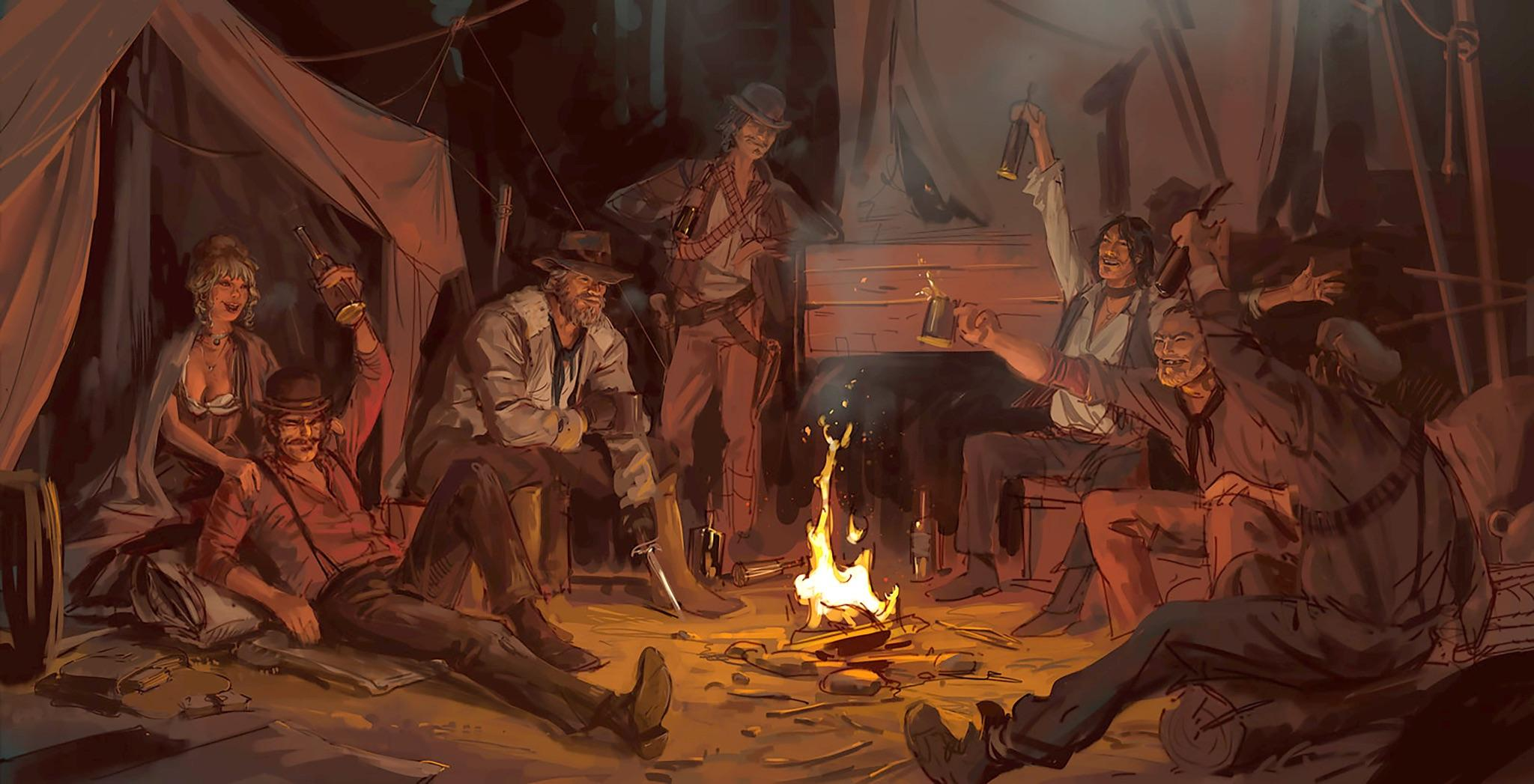
RED DEAD REDEMPTION 2 CONCEPT ART
DAREN BADER/ROCKSTAR GAMES

Slide 5
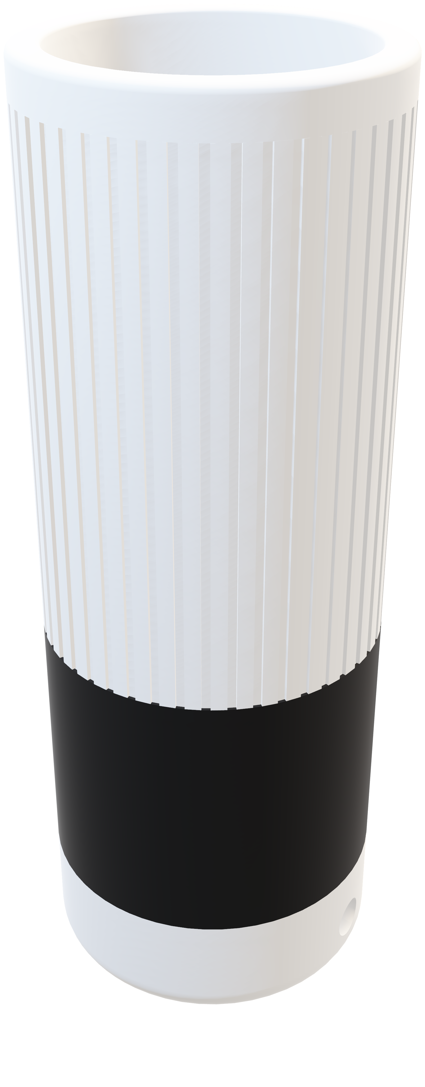
INTRODUCING

Slide 6


Slide 7
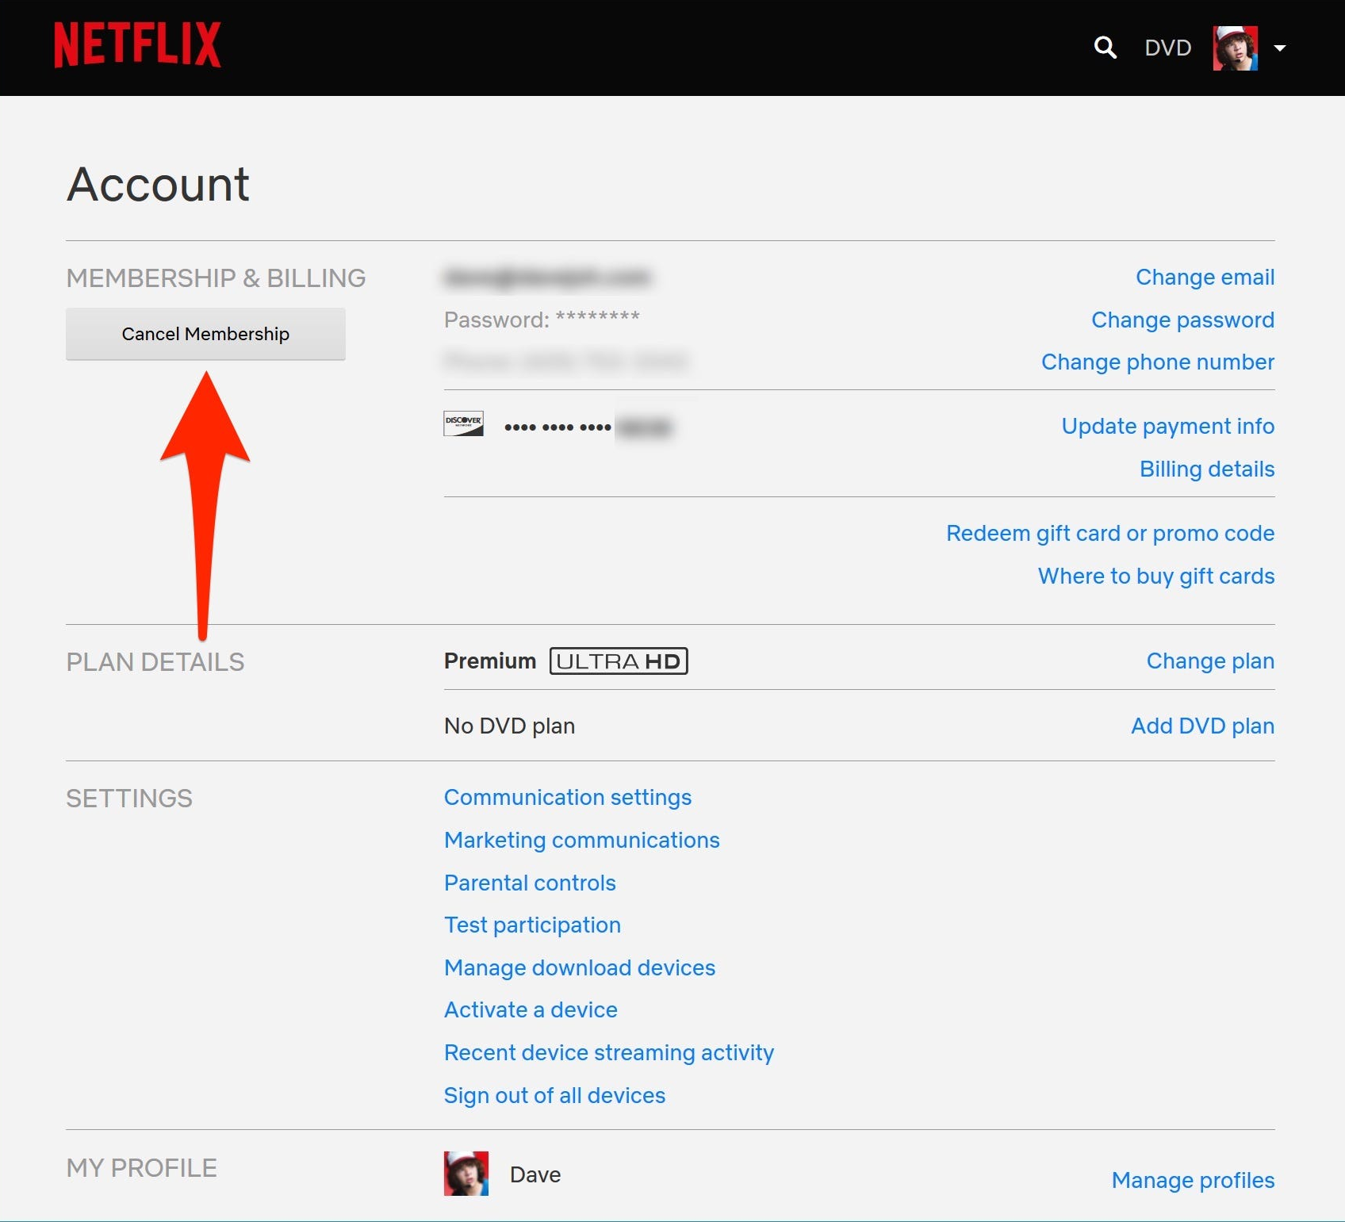

Slide 8
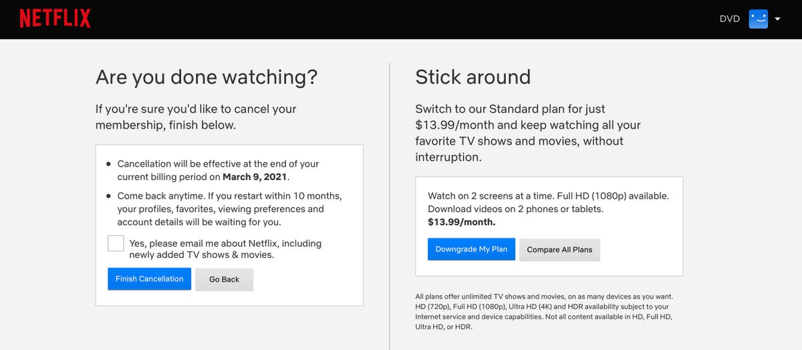

Slide 9
AI ASSISTANT THAT NARRATES STORIES
FOR YOU WHILE DRAWING

Slide 10
EPISODES AND SERIES

Slide 11
CHIPS INSIDE OF PENS

Slide 12
STORY
TEXTURE
FEELING

Slide 13
WHERE IS THE AI PART?

Slide 14
#INTRO
#EVENT1
#EVENT2
#EVENT3
#ENDING

Slide 15
ALIVE STORIES

Slide 16

DEMO

Slide 17

BEAUTIFUL INDUSTRIAL DESIGN
SIMPLE INTERACTION
AI-GENERATED STORIES

Slide 18

ADAM CHATIR, 2024
MASTER MEDIA DESIGN
HEAD-GENÈVE × CARAN D’ACHE

